Slide 1
Function and Input Validation Session 9
Course : COMP6056
Effective Period : September 2021

Slide 2
Sub Topics
Introduction to functions
Random numbers
More library functions
Garbage in garbage out
Input validation Loop
Defensive Programming

Slide 3
These slides have been adapted from: Gaddis, T. (2019). Starting Out with Programming Logic and Design 5^{th.} ISBN: 978-0-13-480115-5 Chapter 6, 7
Acknowledgement

Slide 4
Learning Objectives
At the end of this lecture, students are able to:
LO1: To explain the advantages of using functions.
LO2: To write pseudo-code to solve problem using validation and functions

Slide 5
Functions
A function is a module that returns a value back to the part of the program that called it
Many languages provide libraries of functions that you can use, such as Random Number Generator
A function is like a module, but it returns a value that can be used in your program
Library functions
Written functions that come with most languages
Usually common tasks and save time for the programmer because it allows for code reuse
Gaddis, T., Starting Out With Programming Logic and Design, 5 ed, ISBN: 978-0-13-480115-5

Slide 6
Functions
The Random Number Generator function is useful in:
Game programs
Simulation programs
Statistical programs
Computer security such as encryption
How random function works
Set number = random(1, 100)
1 and 100 define the range of the number that can be returned, and are called arguments
The function is called and a random number is returned and assigned to the variable number
Gaddis, T., Starting Out With Programming Logic and Design, 5 ed, ISBN: 978-0-13-480115-5

Slide 7
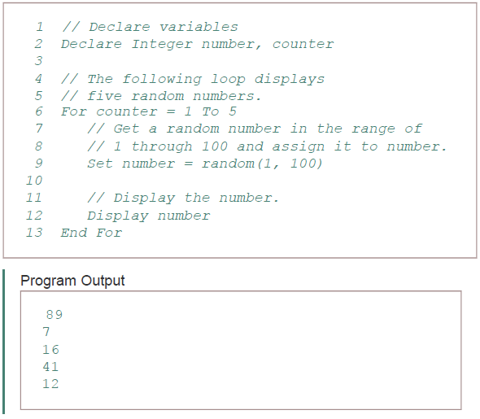
Functions
Gaddis, T., Starting Out With Programming Logic and Design, 5 ed, ISBN: 978-0-13-480115-5

Slide 8
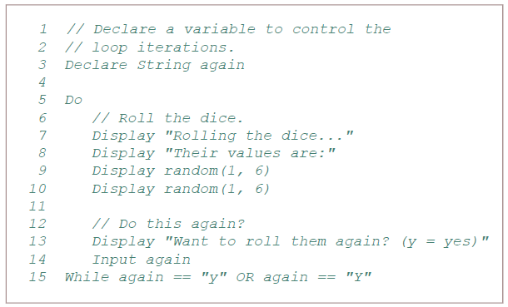
Functions
Gaddis, T., Starting Out With Programming Logic and Design, 5 ed, ISBN: 978-0-13-480115-5

Slide 9
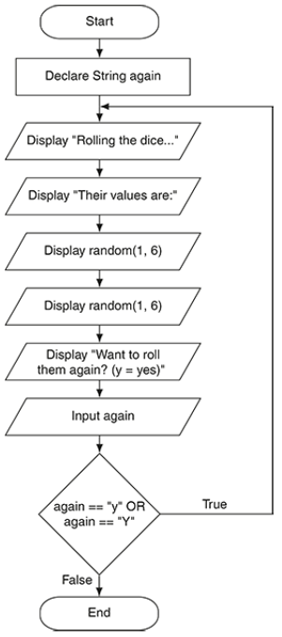
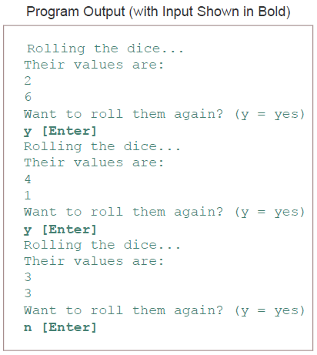
Functions
Gaddis, T., Starting Out With Programming Logic and Design, 5 ed, ISBN: 978-0-13-480115-5

Slide 10
Writing Your Own Functions
Most languages allow coders to write functions
The function header specifies the data type of the value that is returned, the name of the function, and any parameter variables
The function body are the statements that execute when the function calls
The return statement specifies the value that is returned when the function ends
Gaddis, T., Starting Out With Programming Logic and Design, 5 ed, ISBN: 978-0-13-480115-5

Slide 11
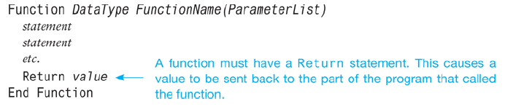
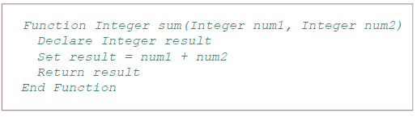
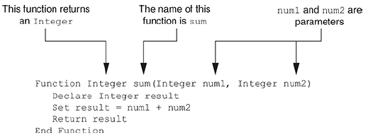
Writing Your Own Functions
Gaddis, T., Starting Out With Programming Logic and Design, 5 ed, ISBN: 978-0-13-480115-5

Slide 12
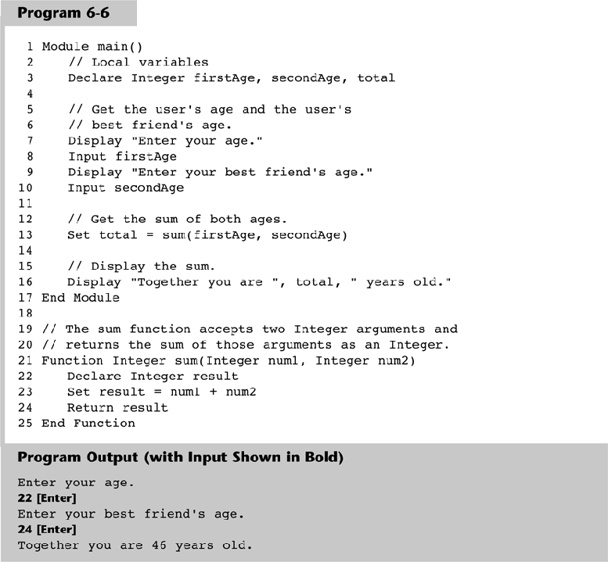
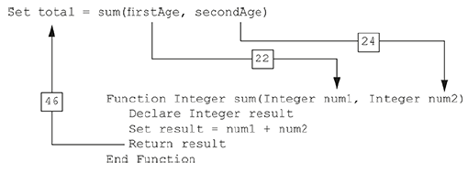
Writing Your Own Functions
Gaddis, T., Starting Out With Programming Logic and Design, 5 ed, ISBN: 978-0-13-480115-5

Slide 13
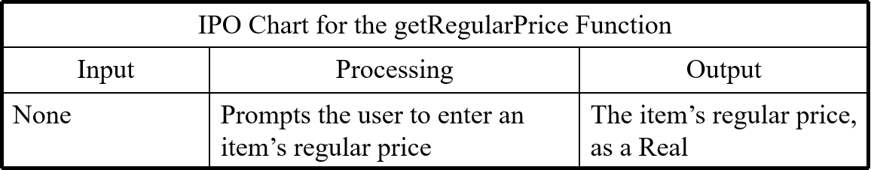
Writing Your Own Functions
Additional concerns
While you can pass as many arguments into a function, you can only return one value
Functions simplify code, increase the speed of development, and ease the facilitation of teamwork
Each function should be flowcharted separately
IPO (input, processing, and output), can be used to show what a function does
Gaddis, T., Starting Out With Programming Logic and Design, 5 ed, ISBN: 978-0-13-480115-5

Slide 14
More Library Functions
Other Common Mathematical Functions
abs calculates the absolute value of a number
cos returns the cosign of an argument
round rounds to the nearest integer
sin returns the sine of an argument
tan returns the tangent of an argument
Gaddis, T., Starting Out With Programming Logic and Design, 5 ed, ISBN: 978-0-13-480115-5

Slide 15
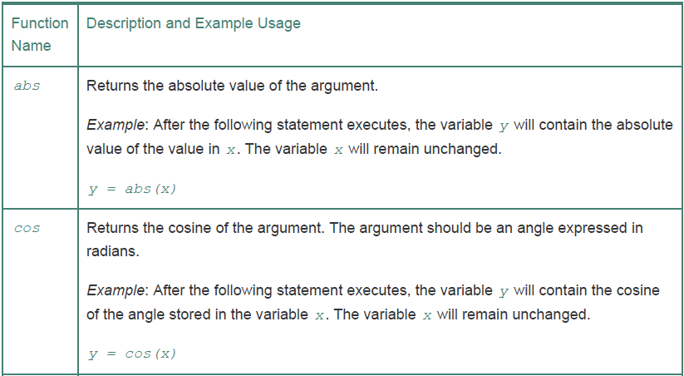
More Library Functions
Gaddis, T., Starting Out With Programming Logic and Design, 5 ed, ISBN: 978-0-13-480115-5

Slide 16
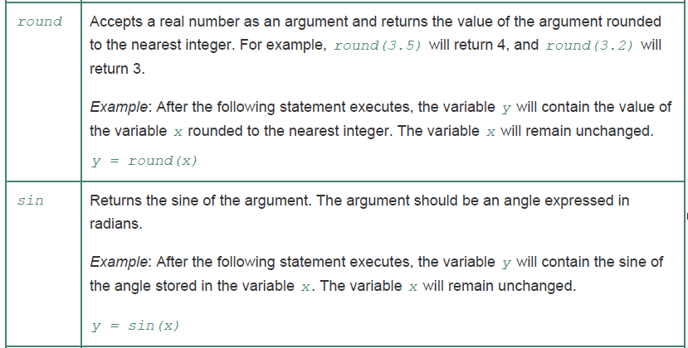
More Library Functions
Gaddis, T., Starting Out With Programming Logic and Design, 5 ed, ISBN: 978-0-13-480115-5

Slide 17
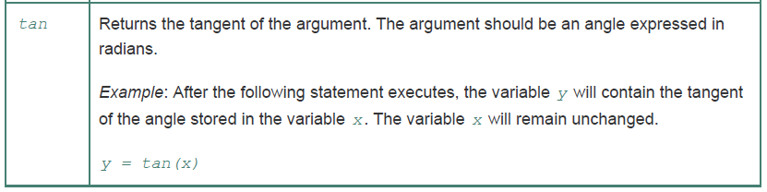
More Library Functions
Gaddis, T., Starting Out With Programming Logic and Design, 5 ed, ISBN: 978-0-13-480115-5

Slide 18
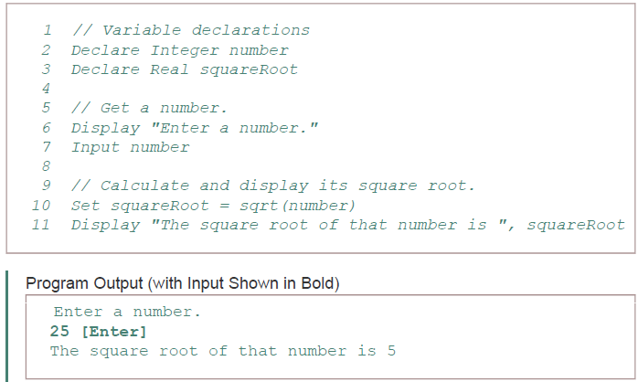
More Library Functions
Gaddis, T., Starting Out With Programming Logic and Design, 5 ed, ISBN: 978-0-13-480115-5

Slide 19
More Library Functions
Data Type Conversion Functions
Library functions that convert values from one data type to another
toInteger converts a real to an integer
toReal converts an integer to a real
Real numbers can store integers
Integers cannot store real numbers
Type mismatch errors will occur without converting values
Gaddis, T., Starting Out With Programming Logic and Design, 5 ed, ISBN: 978-0-13-480115-5

Slide 20
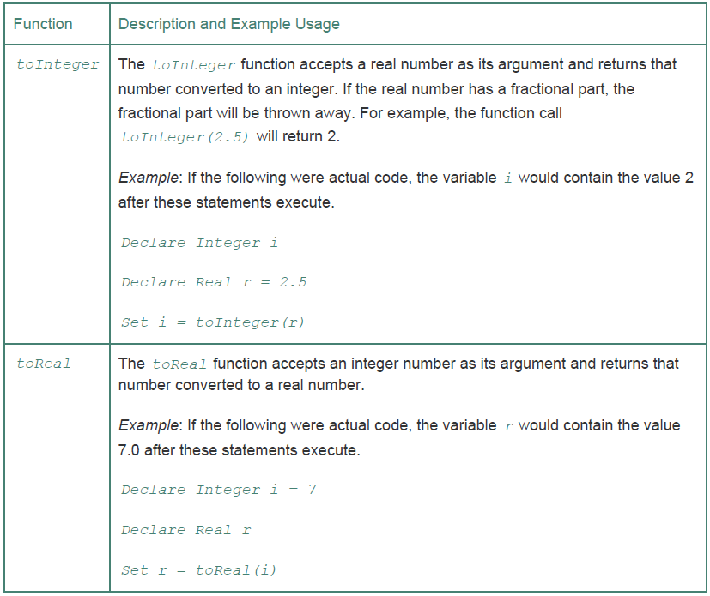

More Library Functions
Gaddis, T., Starting Out With Programming Logic and Design, 5 ed, ISBN: 978-0-13-480115-5

Slide 21
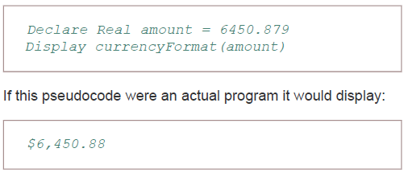
More Library Functions
Formatting Functions
Allow to format a number in a certain way
currencyFormat will be used to format a number to a currency
Gaddis, T., Starting Out With Programming Logic and Design, 5 ed, ISBN: 978-0-13-480115-5

Slide 22
More Library Functions
String Functions
Allow for working with strings
length function returns the length of a function
append function joins multiple strings together
toUpper and toLower converts a string to upper or lower case
substring can extract a character or a portion of a string out of a string
Gaddis, T., Starting Out With Programming Logic and Design, 5 ed, ISBN: 978-0-13-480115-5

Slide 23
More Library Functions
String Functions
contains identifies similar strings within two strings
stringToInteger and stringToReal converts string that stores a number, to a number data type
isInteger and isReal test numbers to see if it can be converted to a string
Gaddis, T., Starting Out With Programming Logic and Design, 5 ed, ISBN: 978-0-13-480115-5

Slide 24
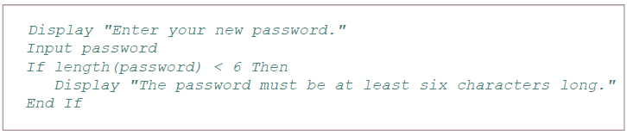
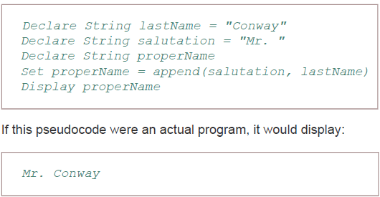
More Library Functions
Gaddis, T., Starting Out With Programming Logic and Design, 5 ed, ISBN: 978-0-13-480115-5

Slide 25
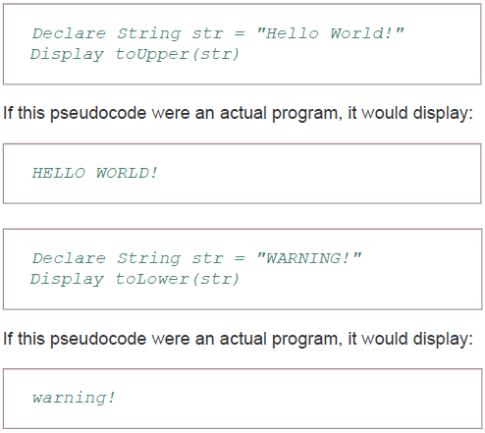
More Library Functions
Gaddis, T., Starting Out With Programming Logic and Design, 5 ed, ISBN: 978-0-13-480115-5

Slide 26
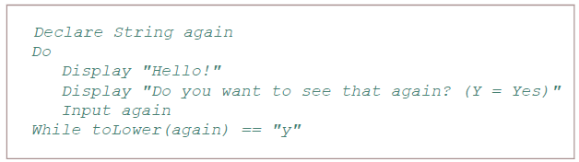
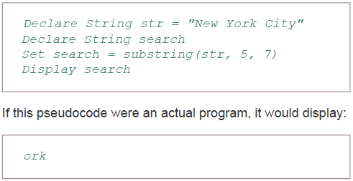
More Library Functions
01 2 345 67 8 9 …
Gaddis, T., Starting Out With Programming Logic and Design, 5 ed, ISBN: 978-0-13-480115-5

Slide 27
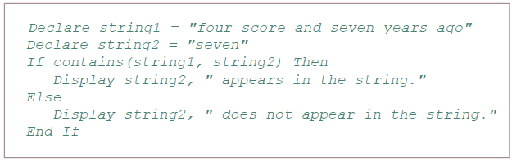
More Library Functions
Gaddis, T., Starting Out With Programming Logic and Design, 5 ed, ISBN: 978-0-13-480115-5

Slide 28
Input Validation
Garbage In, Garbage Out
If a program reads bad data as input, it will produce bad data as output
Programs should be designed to accept only good data
Input Validation
All input should be inspected before processing
If it’s invalid, it should be rejected and the user should be prompted to enter the correct data
Gaddis, T., Starting Out With Programming Logic and Design, 5 ed, ISBN: 978-0-13-480115-5

Slide 29
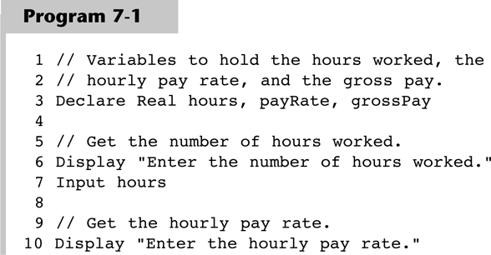
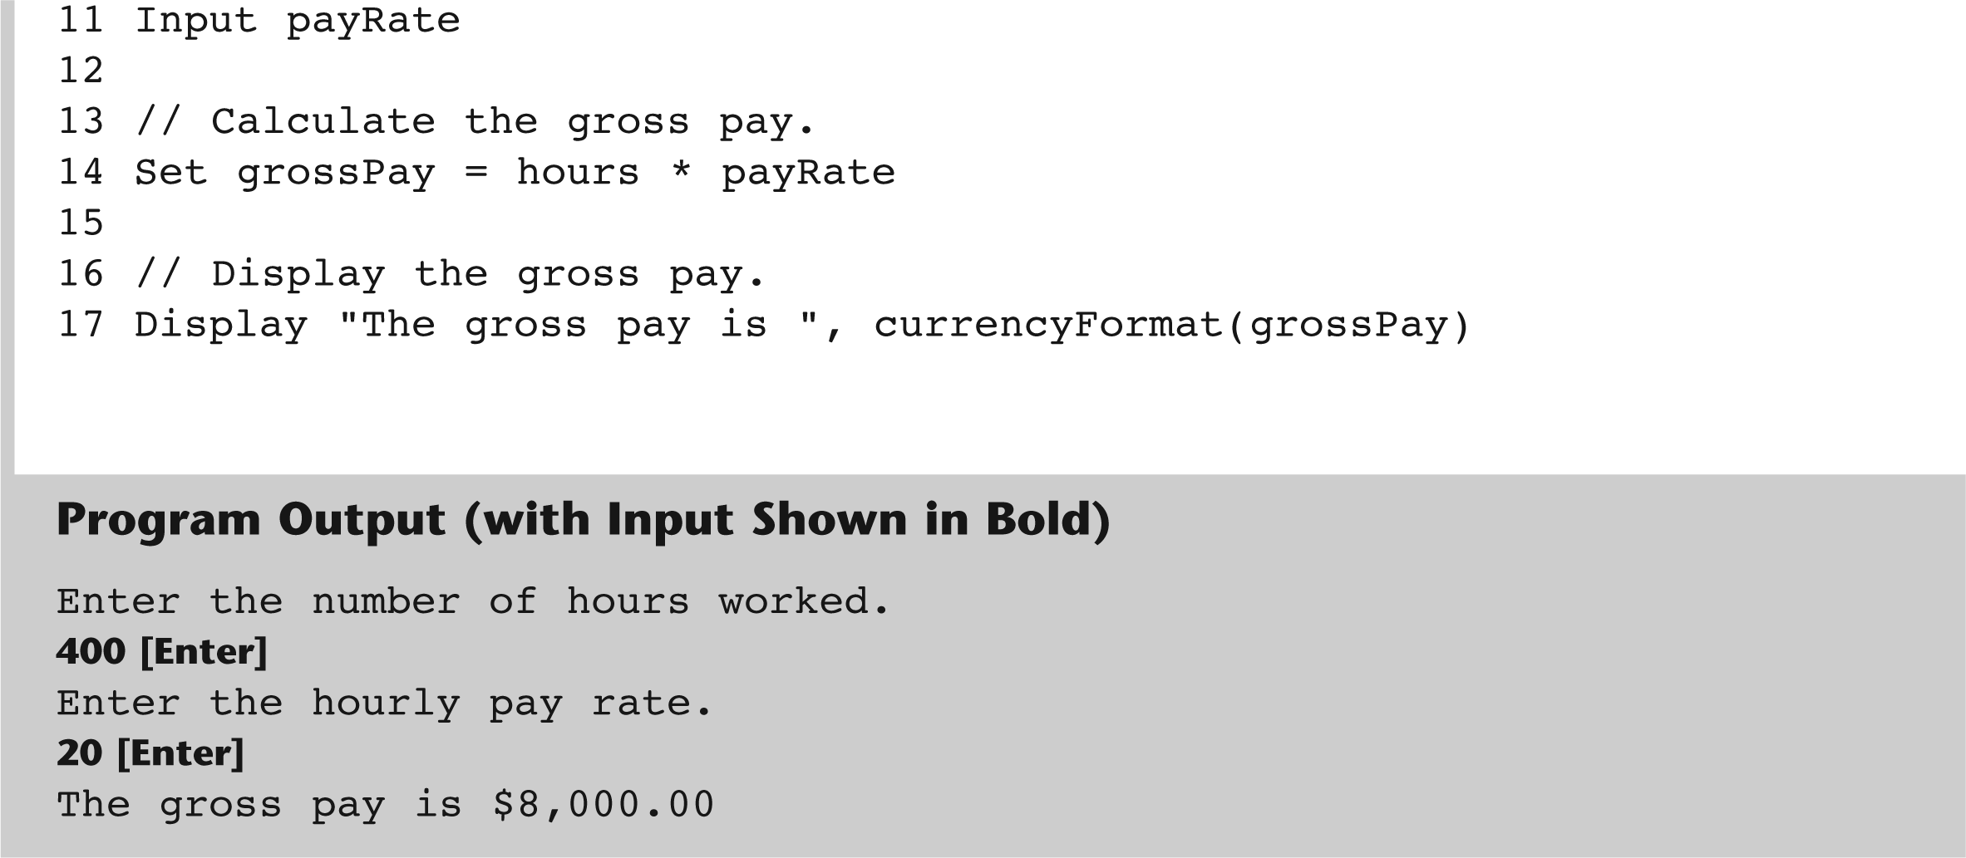
Input Validation
Garbage In, Garbage Out
Gaddis, T., Starting Out With Programming Logic and Design, 5 ed, ISBN: 978-0-13-480115-5

Slide 30
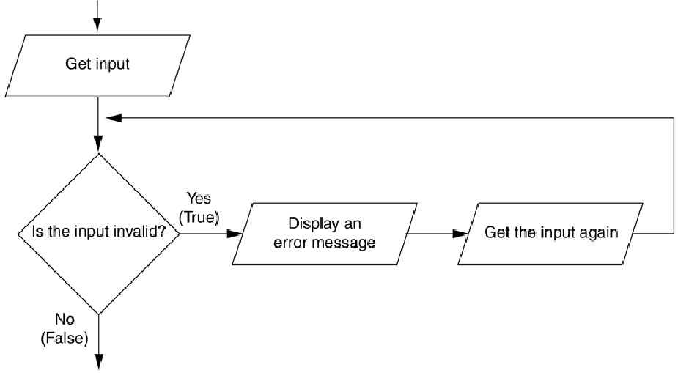
The Input Validation Loop
Input validation is commonly done with a loop that iterates as long as input is bad
Gaddis, T., Starting Out With Programming Logic and Design, 5 ed, ISBN: 978-0-13-480115-5

Slide 31
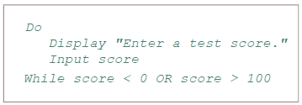
The Input Validation Loop
Priming read is the first input to be tested
// Get a test result
Display “Enter a test score.”
Input score
//Make sure it is not lower than 0.
While score < 0 OR score > 100
Display “ERROR: The score cannot be less than 0 ”
Display “or greater than 100.”
Display “Enter the correct score.”
Input score
End While
Gaddis, T., Starting Out With Programming Logic and Design, 5 ed, ISBN: 978-0-13-480115-5

Slide 32
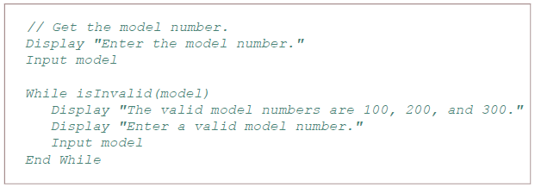
The Input Validation Loop
Writing Validation Functions
For complex validation, it is recommended to write a function.
This process can make the code look cleaner
Gaddis, T., Starting Out With Programming Logic and Design, 5 ed, ISBN: 978-0-13-480115-5

Slide 33
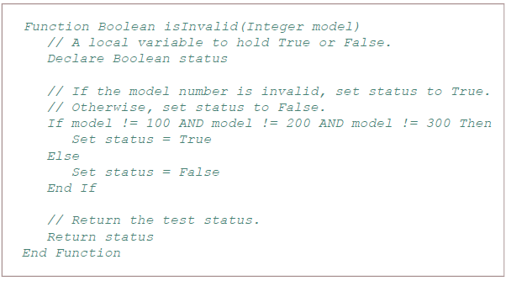
The Input Validation Loop
Gaddis, T., Starting Out With Programming Logic and Design, 5 ed, ISBN: 978-0-13-480115-5

Slide 34
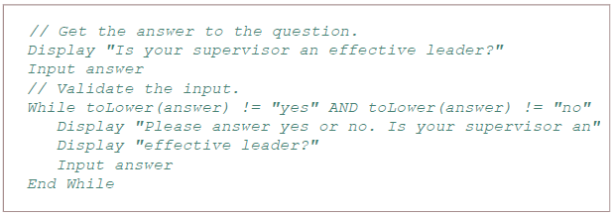
The Input Validation Loop
Validating String Input
Some strings must be validated such as those programs that ask for a specific string input like “yes”
Or programs that specify a string to be a specific length like password validation
Gaddis, T., Starting Out With Programming Logic and Design, 5 ed, ISBN: 978-0-13-480115-5

Slide 35

Defensive Programming
Input validation is defensive programming
The practice of anticipating both obvious and unobvious errors that can happen
Types of errors to consider
Empty input, where a user accidentally hits enter before entering data
The user enters the wrong type of data
Gaddis, T., Starting Out With Programming Logic and Design, 5 ed, ISBN: 978-0-13-480115-5

Slide 36
Defensive Programming
Common errors to be aware of
State abbreviations should be 2-character strings
Zip codes should be in the proper format of 5 or 9 digits
Hourly wages and salary amounts should be numeric values and within ranges
Dates should be checked
Time measurements should be checked
Check for reasonable numbers
Gaddis, T., Starting Out With Programming Logic and Design, 5 ed, ISBN: 978-0-13-480115-5

Slide 37
References
Gaddis, T. (2019). Starting Out with Programming Logic and Design 5th. ISBN: 978-0-13-480115-5

